Slide 1
Unit 3 SQL Server and Oracle

Slide 2
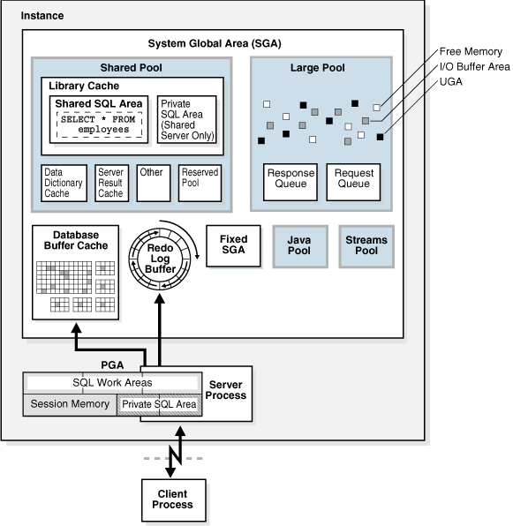
Oracle Database Memory Architecture

Slide 3
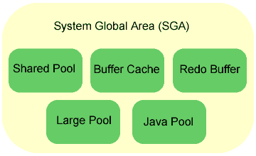
-The SGA is a group of shared memory structures, known as SGA components, that contain data and control information for one Oracle Database instance. -The SGA is shared by all server and background processes. -Examples of data stored in the SGA include cached data blocks and shared SQL areas.
Oracle 11g Memory Management

Slide 4
SQL> STARTUP
ORACLE instance started.
Total System Global Area 368283648 bytes
Fixed Size 1300440 bytes
Variable Size 343935016 bytes
Database Buffers 16777216 bytes
Redo Buffers 6270976 bytes
Database mounted.
Database opened.

Slide 5
Database Buffer Cache
The database buffer cache, also called the buffer cache, is the memory area that stores copies of data blocks read from data files.
A buffer is a main memory address in which the buffer manager temporarily caches a currently or recently used data block.
All users concurrently connected to a database instance share access to the buffer cache.
Three buffer states: Unused, Clean and Dirty.
The database writer (DBW) process periodically writes cold, dirty buffers to disk.

Slide 6
Redo Log Buffer
The redo log buffer is a circular buffer in the SGA that stores redo entries describing changes made to the database.
Redo entries contain the information necessary to reconstruct, or redo, changes made to the database by DML or DDL operations.
Database recovery applies redo entries to data files to reconstruct lost changes.

Slide 7
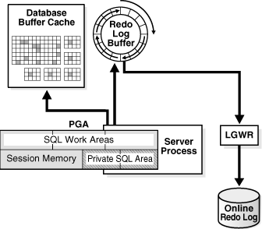
Oracle Database processes copy redo entries from the user memory space to the redo log buffer in the SGA. The background process log writer (LGWR) writes the redo log buffer to the active online redo log group on disk.

Slide 8
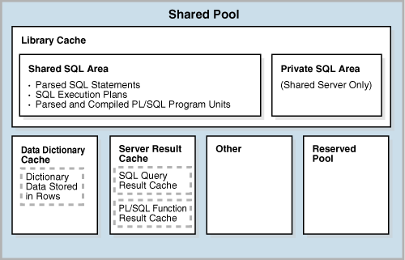
Shared Pool
The shared pool caches various types of program data. For example, the shared pool stores parsed SQL, PL/SQL code, system parameters, and data dictionary information.
The shared pool is involved in almost every operation that occurs in the database. For example, if a user executes a SQL statement, then Oracle Database accesses the shared pool.

Slide 9
Library Cache
The library cache is a shared pool memory structure that stores executable SQL and PL/SQL code.
When a SQL statement is executed, the database attempts to reuse previously executed code. If a parsed representation of a SQL statement exists in the library cache and can be shared, then the database reuses the code, known as a soft parse or a library cache hit. Otherwise, the database must build a new executable version of the application code, known as a hard parse or a library cache miss.

Slide 10
SQL> STARTUP ORACLE instance started. Total System Global Area 368283648 bytes Fixed Size 1300440 bytes Variable Size 343935016 bytes Database Buffers 16777216 bytes Redo Buffers 6270976 bytes Database mounted. Database opened.
SQL> STARTUP ORACLE instance started. Total System Global Area 368283648 bytes Fixed Size 1300440 bytes Variable Size 343935016 bytes Database Buffers 16777216 bytes Redo Buffers 6270976 bytes Database mounted. Database opened.
Oracle 11g Memory Management
Program global area (PGA)
A PGA is a nonshared memory region that contains data and control information exclusively for use by an Oracle process. The PGA is created by Oracle Database when an Oracle process is started.
One PGA exists for each server process and background process. The collection of individual PGAs is the total instance PGA, or instance PGA.

Slide 11
Physical Storage Structures
Data files and temp files
A data file is a physical file on disk that was created by Oracle Database and contains data structures such as tables and indexes. A temp file is a data file that belongs to a temporary tablespace. The data is written to these files in an Oracle proprietary format that cannot be read by other programs.
Control files
A control file is a root file that tracks the physical components of the database.
Online redo log files
The online redo log is a set of files containing records of changes made to data.

Slide 12
Logical Storage Structures
At the finest level of granularity, Oracle Database stores data in data blocks. One logical data block corresponds to a specific number of bytes of physical disk space
An extent is a set of logically contiguous data blocks allocated for storing a specific type of information.
A segment is a set of extents allocated for a specific database object, such as a table.
Each segment belongs to one and only one tablespace.

Slide 13
Oracle Server Tuning
What is Tuning?
SQL Tuning is the process of ensuring that the SQL statements that an application will issue run in fastest possible time.
SQL tuning involves three basic steps:
Identifying high load or top SQL statements that are responsible for a large share of the application workload and system resources.
Verifying that the execution plans produced by the query optimizer for these statements perform reasonably.
Implementing corrective actions to generate better execution plans for poorly performing SQL statements.
These three steps are repeated until the system performance reaches a satisfactory level or no more statements can be tuned.

Slide 14
SQL Tuning Goals
The objective of tuning a system is either to reduce the response time for end users of the system, or to reduce the resources used to process the same work. This can be done by :
Reducing the workload
SQL tuning commonly involves finding more efficient ways to process the same workload. It is possible to change the execution plan of the statement without altering the functionality to reduce the resource consumption.
Resource usage can be reduced by using indexes or b-tree indexes for removing unnecessary full table scan
Balancing the workload
Systems often tend to have peak usage in the daytime when real users are connected to the system, and low usage in the nighttime. If noncritical reports and batch jobs can be scheduled to run in the nighttime and their concurrency during day time reduced, then it frees up resources for the more critical programs in the day.
Parallelize the workload
Queries that access large amounts of data (typical data warehouse queries) often can be parallelized. This is extremely useful for reducing the response time in low concurrency data warehouse. However, for OLTP environments, which tend to be high concurrency, this can adversely impact other users by increasing the overall resource usage of the program.

Slide 15
Parallelize the workload
Parallel execution dramatically reduces response time for data-intensive operations on large databases typically associated with data warehouses Simply expressed, parallelism is the idea of breaking down a task so that, instead of one process doing all of the work in a query, many processes do part of the work at the same time.
An example of this is when four processes handle four different quarters in a year instead of one process handling all four quarters by itself.
The improvement in performance can be quite high. In this case, each quarter will be a partition, a smaller and more manageable unit of an index or table. Parallel execution improves processing for:
Queries requiring large table scans, joins, or partitioned index scans
Creation of large indexes
Creation of large tables (including materialized views)
Bulk inserts, updates, merges, and deletes
You can also use parallel execution to access object types within an Oracle database. For example, you can use parallel execution to access large objects (LOBs).
Parallel execution benefits systems with all of the following characteristics:
Symmetric multiprocessors (SMPs), clusters, or massively parallel systems
Sufficient I/O bandwidth
Sufficient memory to support additional memory-intensive processes, such as sorts, hashing, and I/O buffers

Slide 16
How to read an Oracle execution plan
To execute any SQL statement Oracle has to derive an ‘execution plan’ . The execution plan of a query is a description of how Oracle will implement the retrieval of data to satisfy a given SQL statement. It is nothing but a tree which contains the order of steps and relationship between them.
The basic rules of execution plan tree is below:
1. An execution plan will contain a root, which has no parents 2. A parent can have one or more children, and its ID will be less than the child(s) ID 3. A child can have only one parent, it is indented to the right; in case of many child, it will have the same indentation.

Slide 17
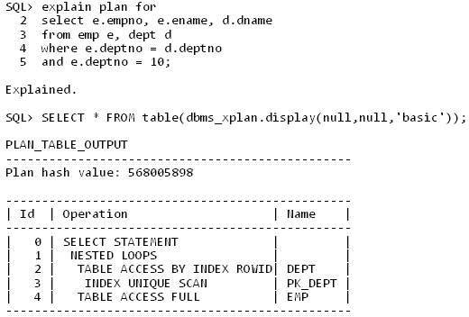
The following is a sample execution plan.

Slide 18
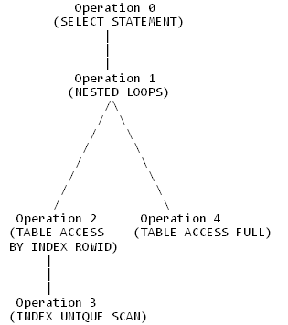
Below is the graphical representation of the execution plan. If you read the tree; In order to perform Operation 1, you need to perform Operation 2 and 4. Operation 2 comes first; In order to perform 2, you need to perform its Child Operation 3. In order to perform Operation 4, you need to perform Operation 2
Operation 3 accesses DEPT table using INDEX
UNIQUE SCAN and passes the ROWID to
Operation 2.
Operation 2 returns all the rows from DEPT table to
Operation 1.
Operation 1 performs Operation 4 for each row
returned by Operation 2.
Operation 4 performs a full table scan (TABLE
ACCESS FULL) scan and applies the filter
E.DEPTNO=10 and returns the rows to Operation 1
Operation 1 returns the final results to Operation 0

Slide 19
SQL Tuning/SQL Optimization Techniques
1) The sql query becomes faster if you use the actual columns names in SELECT statement instead of than '*'.
For Example: Write the query as
SELECT id, first_name, last_name, age, subject FROM student_details;
Instead of:
SELECT * FROM student_details;
2) HAVING clause is used to filter the rows after all the rows are selected. It is just like a filter. Do not use HAVING clause for any other purposes.
For Example: Write the query as
SELECT subject, count(subject) FROM student_details WHERE subject != 'Science‘ AND subject != 'Maths' GROUP BY subject;
Instead of:
SELECT subject, count(subject) FROM student_details GROUP BY subject HAVING subject!= 'Vancouver' AND subject!= 'Toronto';

Slide 20
SQL Tuning/SQL Optimization Techniques
3) Sometimes you may have more than one subqueries in your main query. Try to minimize the number of subquery block in your query. For Example: Write the query as
SELECT name FROM employee WHERE (salary, age ) = (SELECT MAX (salary), MAX (age) FROM employee_details) AND dept = 'Electronics';
Instead of:
SELECT name FROM employee WHERE salary = (SELECT MAX(salary) FROM employee_details) AND age = (SELECT MAX(age) FROM employee_details) AND emp_dept = 'Electronics';

Slide 21
SQL Tuning/SQL Optimization Techniques
5) Use EXISTS instead of DISTINCT when using joins which involves tables having one-to-many relationship.
For Example: Write the query as
SELECT d.dept_id, d.dept FROM dept d WHERE EXISTS ( SELECT 'X' FROM employee e WHERE e.dept = d.dept);
Instead of:
SELECT DISTINCT d.dept_id, d.dept FROM dept d,employee e WHERE e.dept = d.dept;

Slide 22
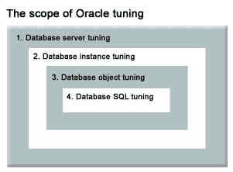
Scope of Oracle Tuning

Slide 23
Four part tuning approach
Server and Network tuning :
If there is a problem with the Oracle server, such as an overloaded CPU, excessive memory swapping or a disk I/O bottleneck, no amount of tuning is going to improve the performance. Hence the first thing is the server and network environment examination.
Instance tuning :
Oracle initialization parameters must be reviewed to ensure that the database has been properly configured, looking for resources shortage in db_block_bufers, shared_pool_size and short_area_size.
Object tuning :
Setting of Oracle tables and indexes. At this phase we look at the settings that govern the behaviour of the table and determine how well the settings accommodate the needs of the individual data base.
SQL tuning :
This is the most time consuming tuning operation because there can be many thousands of individual SQL statements that access the Oracle database . At a high level, we identify the most common SQL statements , tune each of them very carefully reviewing the execution plan for the SQL and adjust the SQL plan using Oracle hints.

Slide 24
Some tools for Oracle Tuning
Because the manual tuning process poses many challenges to the application developer, the SQL tuning process has been automated by the automatic SQL tuning manageability features.
ADDM (Automatic Database Diagnostic Monitor)
SQL Tuning Advisor
SQL Tuning Sets
SQL Access Advisor

Slide 25
Tips on Oracle performance Tuning
SQL functions rarely perform well. They cause the query to go single threaded. Therefore, to reuse code, use stored procedures and views instead of functions. Functions have huge drawbacks in the database tier.
Tuning memory with memory advisor.
Monitor poor and good indexes.
Monitor sub query usage and coding techniques.
Selecting appropriate back up strategies.
Reducing I/O with multiple buffer pools.
Enabling total memory management with AMM (Automatic memory Management).
Performing root cause analysis with ADDM (Automatic Database Diagnostic Monitor).
Tuning the buffer cache with buffer cache advisor.

Slide 26
SQL Server
Like all database systems, the SQL Server performs extremely complex tasks like memory management, optimum CPU utilization, query optimization, execution planning etc. at a lightning fast speed.

Slide 27
Functions of SQL Server
Databases
Every SQL server has 2 types of files
Data files (tables/indexes/views/procedures)
Every data dile can be further classifies as Primary or Srcondary
Primary files have extension .mdf and secondary file have .ndf.
Log files (contain recovery information) – Extension is .ldf
Database Files and File Groups
A file group may contain data files and the properties of all data files can br simultaneously managed with a file group.
Every database has a primary file group. There are 2 types of file groups:
Primary FG : it is the default file group.
Secondary FG
Transaction Logs
Backup and Recovery
Microsoft Clusters
Protocols
Disaster Recovery

Slide 28
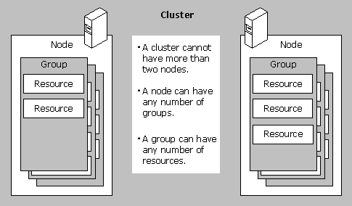
M
Microsoft Clusters
A Microsoft SQL Server Cluster is nothing more than a collection of two or more physical servers with identical access to shared storage that provides the disk resources required to store the database files.
These servers are referred to as "nodes".
Advantages of Clusters:
High Availability of Resources
Centralized Administration
Scalable, but Affordable

Slide 29
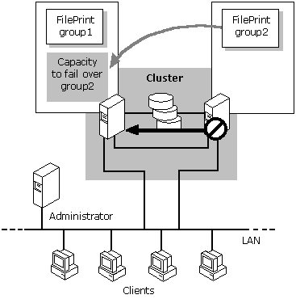
Microsoft Clusters
When a SQL Server instance is installed on the cluster, system and user databases are required to be on the shared storage. That allows the cluster to move the SQL instance to any server (or “node”) in the cluster whenever you request, or if one of the nodes is having a problem. There is only one copy of the data, but the network name and SQL Server service for the instance can be made active from any cluster node.

Slide 30
Database Server
Database server is the computer where SQL Server service is running
SQL Server runs as a processes in NT
More than one SQL Server can run on a single computer
This is possible only with version SQL Server 2000 and not with version SQL Server 7.0
SQL Server is a Relational Database Management System
All the database are accessed and managed through the Server

Slide 31
SQL Server Client tools
SQL Enterprise Manager
It is the primary administrative tool and provides a Microsoft management Console user interface that allows user to:
Administer database objects, users and permissions in each registered server.
Defines group of servers running SQL server
Design and execute SQL statement, batches and scripts interactively by invoking SQL query analyzer.
SQL Query Analyzer
It can be started from SQL enterprise manager by using its tool menu.
Users can interactively design and execute queries.
Query designer is a GUI toll for designing queries used in specific objects.
Service Manager
It is used to start, stop and pause SQL server components. These components run as services as separate executable programs.
There is one SQL server service for each instance of SQL server running on computer.
It is a small taskbar application which when minimized, appears in the area of taskbar clock o n the right of the taskbar.
Server & Client Network Utility
Enable and Disable Network Protocol
Index Tuning Wizard
Data Transformation Services

Slide 32
SQL Server Client tools
Performance Monitor
Monitoring helps in :
Determining whether performance improvements can be made.
Determining user activity to find out what queries user are issuing and who is connected to SQL server.
Troubleshooting problems
Testing applications
SQL Profiler
SQL Profiler is a tool that captures SQL Server events from the server and saves those events in what's known as a trace file. You can then analyze or use the trace file to troubleshoot logic or performance problems. You can use this utility to monitor several areas of server activity, such as: Analyzing and debugging SQL statements and stored procedures.
Monitoring slow performance.
General debugging and troubleshooting.
Fine-tuning indexes.
An event is an action generated within an instance of SQL Server Database Engine. Examples of these are:
Login connections, failures, and disconnections.
SQL SELECT, INSERT, UPDATE, and DELETE statements.
The start or end of a stored procedure.
A lock acquired or released on a database object.
An opened cursor.
Security permission checks.

Slide 33
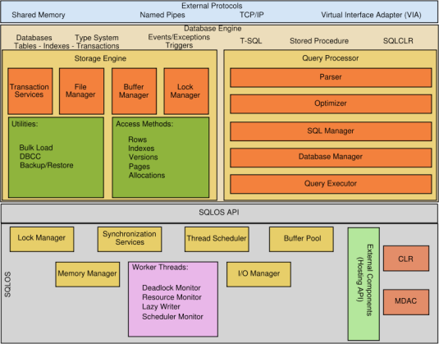
SQL Server Architecture

Slide 34
SQL Server Architecture
There are 3 important items here:
Database Engine: Performs the storage and query processing tasks
SQL Operating System: Works on I/O and other higher level management tasks
Interfaces: The External Protocols and SQL Operating System API connect the dots

Slide 35
SQL Server Architecture
The Database engine is the heart of Microsoft SQL Server. Think of it as the engine of a motorcycle, it is the part where the real stuff happens. It contains 2 major components:
Query processor: Parses, optimizes and executes the query
Storage engine: Manages buffer and access methods

Slide 36
SQL Server vs Oracle
Performance
Sql Server is quite simple and easy to administer, and it works just fine for databases that are less than a few hundred gigabytes. Yet once the database grows beyond that, performance degradation starts to occur.
Oracle offers hundreds of database-level tuning options and features to improve performance. One example is a feature called Real Application Clusters (or RAC). This feature allows multiple servers to operate concurrently on the same database, thereby giving more processing power to the company's application.

Slide 37
SQL Server vs Oracle
Choice of OS Platform
Sql Server is limited to the Microsoft Windows operating system and will not work on any flavor of Unix operating systems.
Oracle, on the other hand, can work on Microsoft Windows, or any flavor of Unix operating systems, making it a true enterprise solution.

Slide 38
SQL Server vs Oracle
Scalability
Sql Server only supports vertical scalability. The only way to scale a system built on sql server technology is to add more memory and CPU to the single server hosting the database.
Like Sql Server, one could scale a system built on Oracle by adding more memory and CPU to the single server hosting the database.

Slide 39
SQL Server vs Oracle
In SQL Server, no range partitioning of large tables and indexes. In Oracle, a large 100 GB table can be seamlessly partitioned at the database level into range partitions.
For example, an invoice table can be partitioned into monthly partitions. Such partitioned tables and partitioned indexes give performance and maintenance benefits and are transparent to the application

Slide 40
SQL Server vs Oracle
Microsoft SQL Server User-Defined Data Types
This Microsoft SQL Server T-SQL-specific enhancement to SQL allows users to define and name their own data types to supplement the system data types.
Note:
User-defined data types make the data definition language code and procedural SQL code less portable across different database servers.

Slide 41
SQL Server vs Oracle Data Types
SQL Server | Description | Oracle
INTEGER | Four-byte integer, 31 bits, and a sign. May be abbreviated as "INT" | NUMBER(10)
SMALLINT | Two-byte integer, 15 bits, and a sign. | NUMBER(6)
REAL | Floating point number. Storage is four bytes and has a binary precision of 24 bits, a 7-digit precision. | FLOAT
FLOAT | A floating point number. This column has 15-digit precision. | FLOAT
DATETIME | Date and time are stored as two 4-byte integers. DATETIME have a default value of 1/1/1900. | DATE
BIT | A Boolean 0 or 1 stored as one bit of a byte. Bit data cannot be NULL, except for Microsoft SQL Server 7.0, where null is allowed by the BIT data type. | NUMBER(1)
CHAR(n) | Fixed-length string of exactly n 8-bit characters, blank padded. Synonym for CHARACTER. 0 < n < 256 for Microsoft SQL Server. 0 < n < 8000 for Microsoft SQL Server 7.0. | CHAR(n)
VARCHAR(n) | Varying-length character string. 0 < n < 256 for Microsoft SQL Server. 0 < n < 8000 for Microsoft SQL Server 7.0. | VARCHAR2(n)
TEXT | Character string of 8-bit bytes allocated in increments of 2k pages. "TEXT" is stored as a linked-list of 2024-byte pages, blank padded. | CLOB
IMAGE | Binary string of 8-bit bytes. Holds up to (231-1) bytes of binary data. | BLOB
BINARY(n) | Fixed length binary string of exactly n 8-bit bytes | RAW(n)/BLOB

Slide 42
Questions
What are the different features of SQL server?
What are the salient features of Oracle?
Compare the security features of SQL server and Oracle.
Discuss the common and distinguish features of SQL server and Oracle.
What are the different components of a SQL server?

